Slide 1
Hacking the CAF If you can’t beat ‘em, join ‘em!
Jon R. Lindsay
Assistant Professor of Digital Media and Global Affairs
Munk School of Global Affairs
University of Toronto
jon.lindsay@utoronto.ca
Defence Engagement Program Executive Panel
Ottawa
10 June 2016

Slide 2
Objectives
What are the cross-domain links between cyber, space, and conventional deterrence? What are the unique challenges and opportunities in new domains?
How should CAF operate in cyber? What skills do planners need? What operations and activities should CAF expect to undertake?

Slide 3
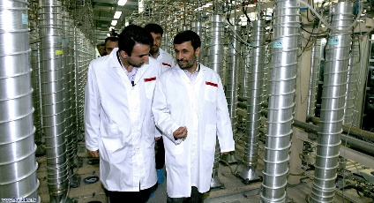
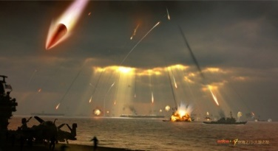
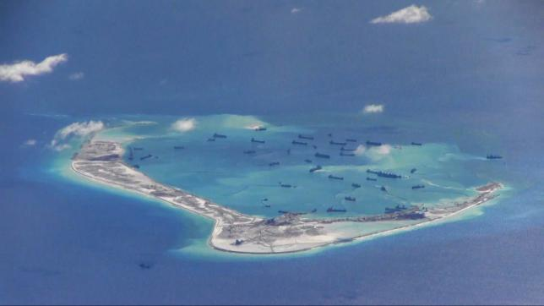
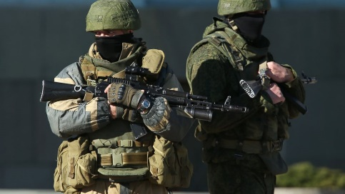
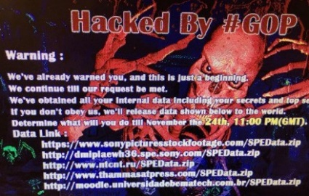
“Cross-Domain Deterrence”
Emerging technologies
“Cyber” as a strategic opportunity
“Command of the commons” vs. A2/AD & ASATs
ASD Global Strategic Affairs 2010 CDD workshop
Attribution? Armed attack? Misperception? Escalation?
“Gray Zone” threats
Stuxnet: sabotage + assurance + diplomacy
Ukraine: spec ops + info ops + nuclear threats
South China Sea: islands + civilian vessels + trade
Sony: doxing + terrorism + attribution + sanctions
Notes:
CDD is a peculiarly American policy concern: new techs will undermine primacy
Gray zone characteristics: aggression combining domains to work around deterrent (real or implied)—aggressor constrained

Slide 4
Advancing Deterrence Theory
Literature
Opportunities
Waves 1-2 (1950s-60s)
Nuclear Bipolarity
Chicken & PD Games
Wave 3 (Late 1960s-80s)
Empirical tests
Questioning rationality
Wave 4 (1990s-2000s)
Relaxing assumptions on bipolarity & preferences
New problems: terrorism, proliferation, rogues, cyber
Clarify aims of “deterrence”
Maintain the status quo?
Maximize bargaining gain?
Minimize cost?
Minimize escalation risk?
Theorize choice of means
Increasing portfolio
Globalization & dual-use
Differential costs
Signaling feasibility
Shannon Carcelli, “Blast from the Past: Updating and Diversifying Deterrence Theory,” CDD Working Paper, March 2016
Notes:
CDD policy concern also an opportunity to advance theory
Deterrence has many ends, and many means

Slide 5
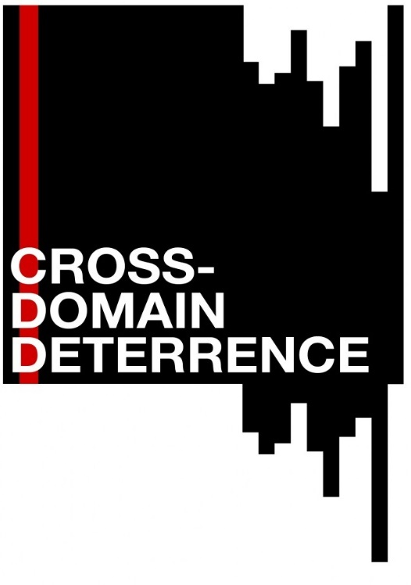
Means Matter
http://deterrence.ucsd.edu
Force serves (at least) 2 different bargaining functions
WINNING: Change the balance of power
WARNING: Signal interests & resolve
Means can have a differential effect on ends
Naval tonnage → disputes further away, but more of them
Ground force deployments to allies → fewer disputes
Recce satellites → less likely to be the target of a dispute
Unmanned drones → asymmetric resolve & civ targeting
Cyber deception → limits on offense & poor signaling
Combinations can produce synergies or tradeoffs
Combined arms warfare → improve probability of victory
Nuclear transparency + cyber secrecy → crisis instability
Notes:
Summary of preliminary findings from UCSD-UoT-UCB-LLNL Minerva project

Slide 6
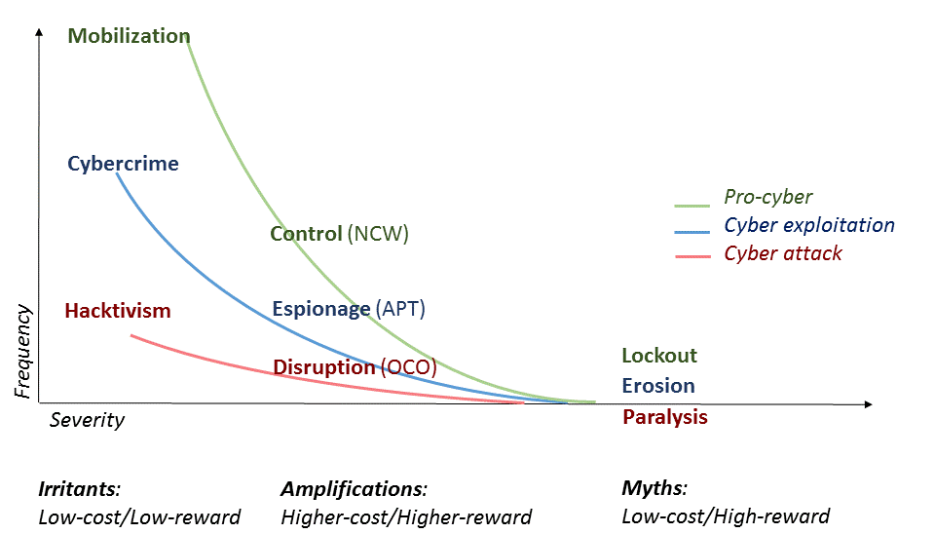
Bad News and Good News in Cyberspace
Denial: Many lack the ability to go big
Consequences: Others lack motivation
Threats predicated on increasing utility
Notes:
Pro > exploit > atk
Irritants > amplifications > myths
Deterrence fails because it succeeds
Consequences: retaliation and future utility
Security vs. innovation tradeoffs in society AND within military organization

Slide 7
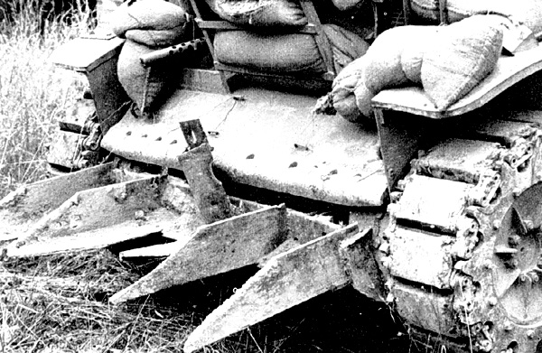
Hacking to Win
Notes:
The Sgt Cullins Tank—German beach obstacles welded onto M-4 Sherman tanks to bulldoze through hedgerows

Slide 8
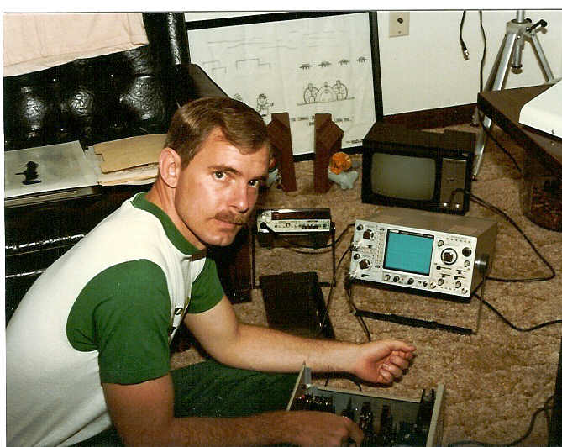
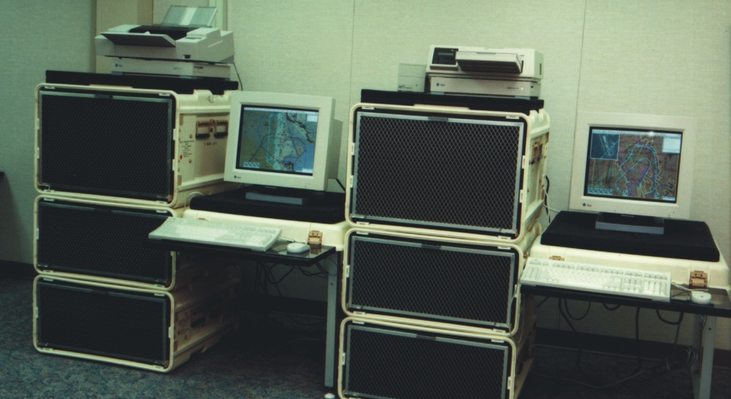
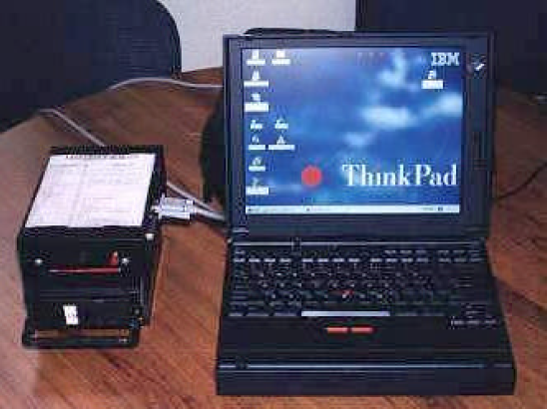
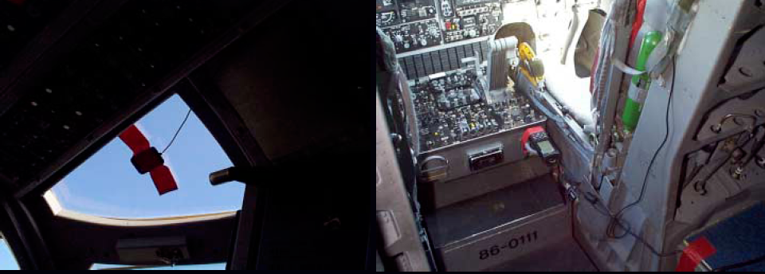
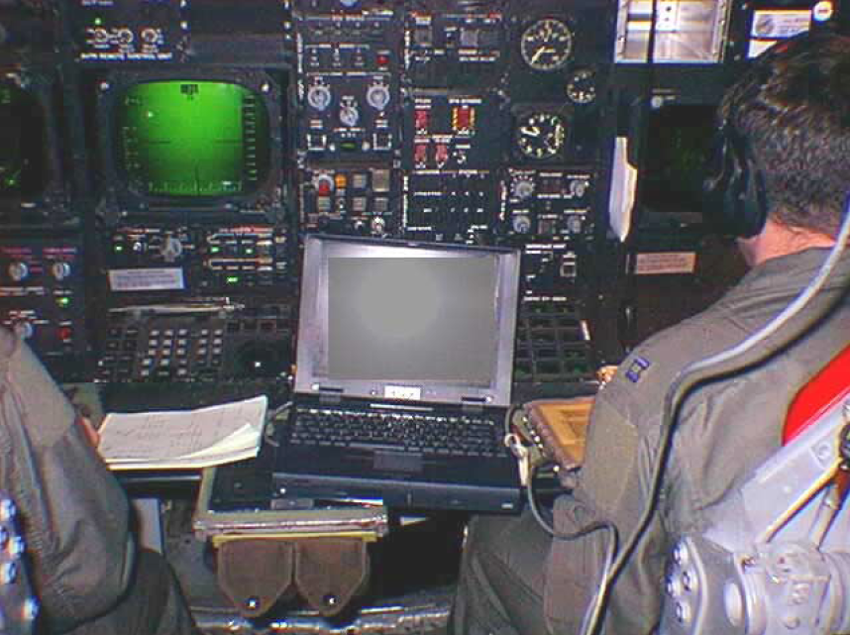
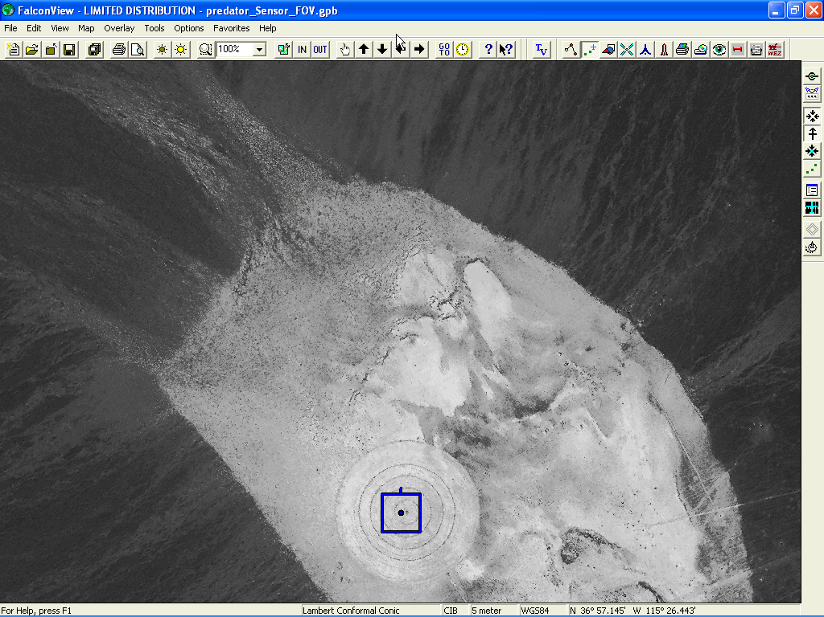
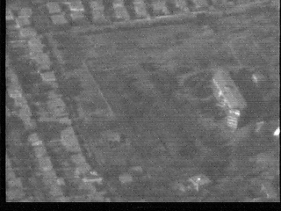
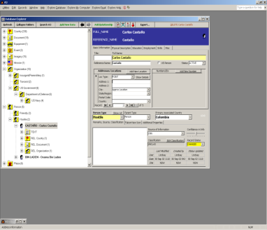
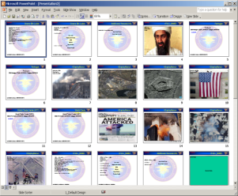
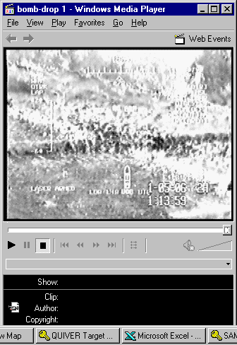
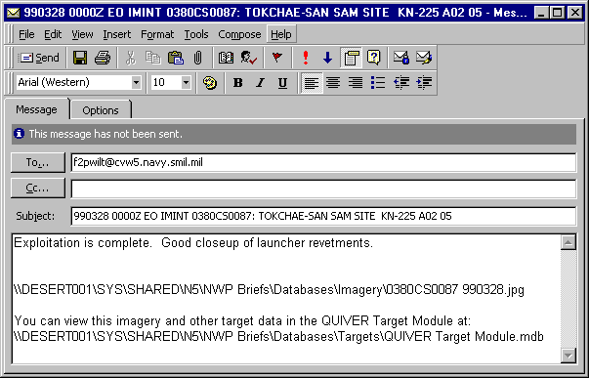
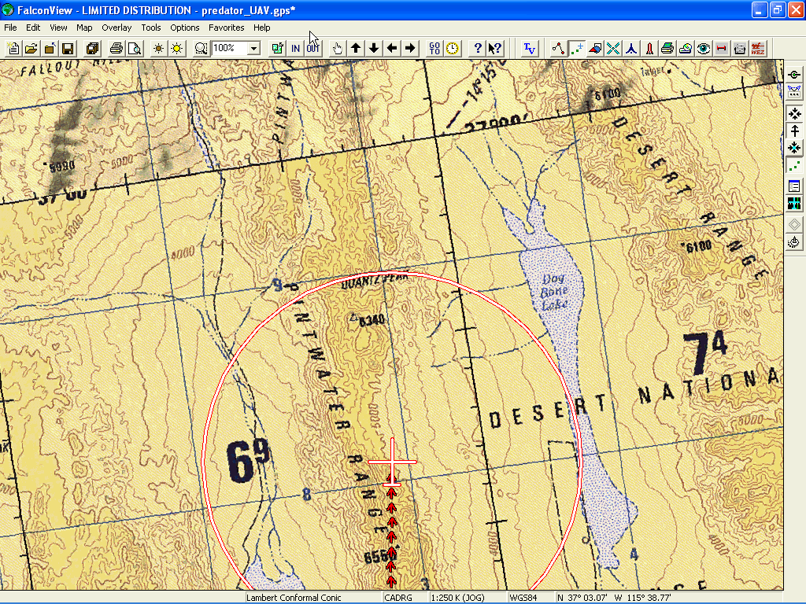
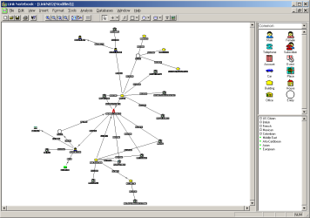
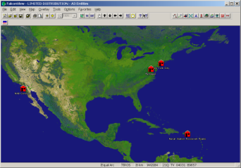
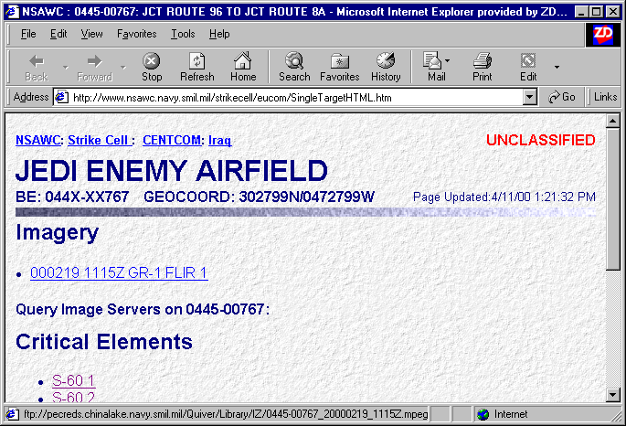
CY
02
03
04
05
06
07
08
CY
NavMPS
Naval TACAIR & Weapons
TAMPS/TEAMS/MOMS/MSS/NAWC
Naval Helos & Maritime
N-PFPS
JMPS 1.1
JMPS 1.2.3?
?
SOFPARS
SOF
Helo
PFPS
JMPS 1.3
Fighters
JMPS 1.2.2
AFMSS
Airlift
MPS II
MPS III
MPS IV
UAV, PGM’S
F-15E
JMPS 1.2.1
B-1, B-52
B-2, F-117, JSF
AMPS
PFPS
JMPS 1.2.4
Army Helos
Some platforms will migrate depending on JMPS ability to meet requirements
Navy, Marine Corps, Air Force, Army and SOF Working Together
Intuitive Interface
PowerPoint
Video Feed
Video Feed
Video Feed
Decoder
Decoder
Decoder
Digital Library
Email
Ta+3637444To-11528023Tw891Sr3.714.99Se-22.34Fv1.71Sl11014Sa+3639111So-11531557Sn2Cd20000823Ct175544Ir-0.95Ip-0.31Ih173.38Ic0Mn23Md0Mt0Cl0Pc0Iv0
Ta+385To-11536024Tw8983Sr5.47Sp218.64Se-14.95Fv11.55Sl11024Sa+3639065So-11531546Sn2Cd20000823Ct175548Ip-0.33Ih173.73Ic0Mn23Md0Mt0Cl0Pc0Iv0
Ta+3634595To-11536021Tw85.43Sp218.99Se-15v11.55Sl11028S39029So-11531539Sn2Cd20000823Ct175550Ir-0.34Ip-0.58Ih173.50Ic0Mn23Md0Pc0Iv0
Ta+3634577To-11536010Tw8r5.40Sp24Se-15.155Sl11033638582So-11531529Sn2Cd20000823Ct175554Ir-0.37Ip-0.87Ih173.66Ic0Mn23Md0Mt0Cl0Pc0Iv0
SuperSplitter Program
CAOC Skycab
CAOC Floor
ISRD
FalconView
FalconView
FalconView
Link Analysis
FalconView
Web Content
Notes:
Falconview—a saga of user innovation outpacing the procurement offices

Slide 9
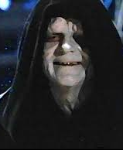
Hacking is Inevitable
The gap between use and design is shrinking
No longer just “cyber” security
Generativity & utility is a root cause of network insecurity
Overzealous security measures can undermine network utility
Personnel will work around red tape to accomplish their mission
Use these powers for good
Push technical expertise forward
Leverage user innovation communities
Promote mission-type over task-type regulation
Educated, democratic forces have advantages
Operational advantages of hacking
Adaptive in war
Affordable prototyping
Inscrutable to the enemy (including active defense)
Human-centric
Notes:
educe

Slide 10
Concluding thoughts
Complexity is a problem
“Cyber” is less of a new “domain” and more symptomatic of increasing sociotechnical complexity worldwide
Many means can serve many ends, complicating strategic choice and enabling “gray zone” challenges
Complexity is also an opportunity
Would-be revisionists are more constrained than ever before, by deterrence and stakeholder value
The “third offset” is organizational, not technological

Slide 11
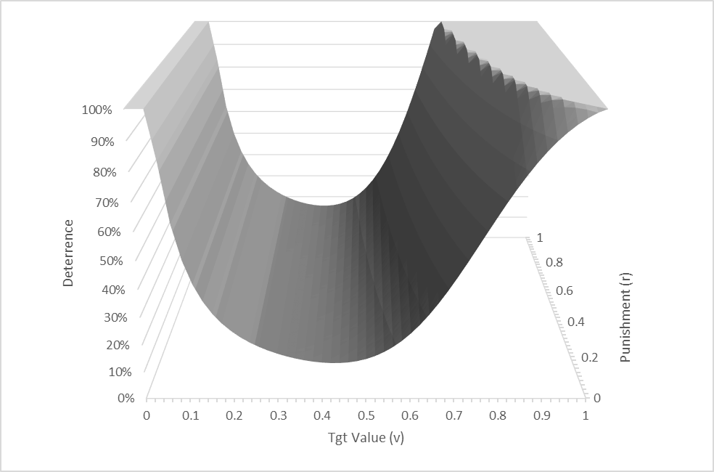
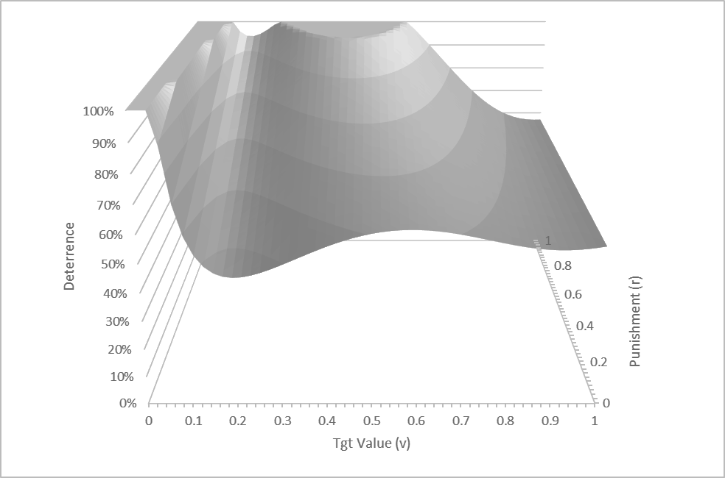
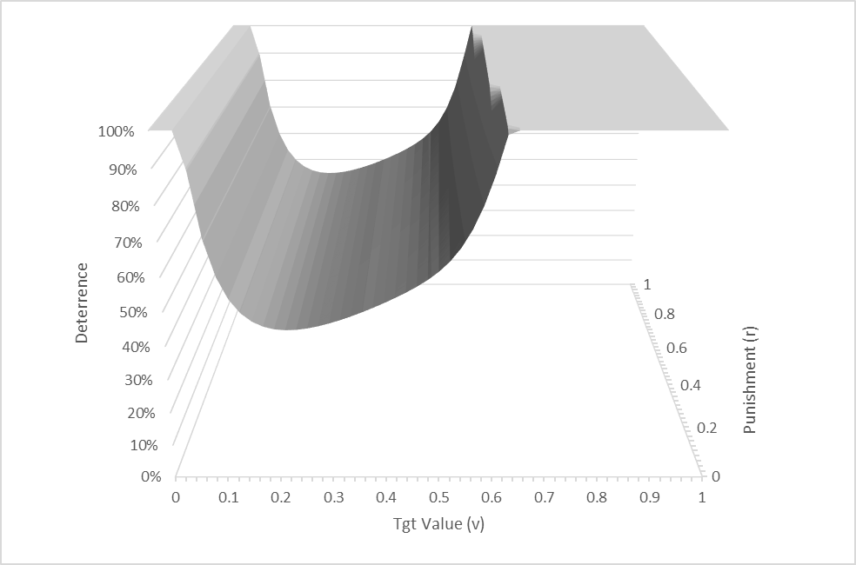
Offense, Defense, Uncertainty, and Scale
↓Offense, ↑Defense, ↑Uncertainty
Huge deterrence failure, but big threats protect highest value targets
(The cyber revolution thesis)
Costs scale with target value, defense scales > offense
Denial & punishment improves, but retaliation not credible at high end
(Where are all the big attacks?)
↑Offense, ↓Defense, reciprocal scaling with value
Deterrence feasible for high value targets, non-credible at the low end
(More consistent w/ evidence)
Declaratory ambiguity trades coverage for effectiveness
Prioritize assets most worth protecting
Exploit gray zones to clarify interests & resolve
Jon Lindsay, “Tipping the Scales: The Attribution Problem and the Feasibility of Deterrence against Cyber Attack,” Journal of Cybersecurity 1:1 (2015)

Slide 12
Conceptual Framework
Increasing Complexity
Sources of Uncertainty
change the balance of power (Winning)
Actors have a portfolio of bargaining moves to…
revise or reinforce the status quo
Political uncertainty:
signal interests & resolve (Warning)
Power
Costs
Demands
Outcomes
Credibility
The future
Increasing political complexity
New means for winning and warning
New linkages and interdependence
New bargaining relationships
Political Strategy
Military Operations
Military uncertainty:
Militaries pursue new means for winning
Capabilities
Disposition
Infrastructure
Organization
Doctrine & plans
Logistics & C4ISR
Increasing military complexity
New complements
New substitutes
New combinations
Arms race
Lethality
Protection
Force employment
Specialization
Coordination

Slide 13
Project Organization
Program Management
US DoD Minerva Initiative
ONR
UCSD
Erik Gartzke (PI)
Rex Douglas
Grad Students
Jason Lopez (Administrator)
LLNL
Benjamin Bahney
Peter Barnes
Celeste Matarazzo
Braden Soper
LANL
Joseph Pilat
UC Berkeley
Michael Nacht
Grad Students
U Toronto
Jon Lindsay (co-PI)
Grad Students
Data subaward
U Maryland
Jonathan Wilkenfeld
Grad students
Duke
Kyle Beardsley
Modeling
Policy Expertise
Qualitative Analysis
Quantitative Analysis

